Slide 1
BHARATHIAR UNIVERSITY, COIMBATORE
DEPARTMENT OF COMPUTER APPLICATIONS
HAND GESTURE BASED ON MEDIAPLAYER CONTROL SYSTEM
Under the guidance of , Project by,
Dr. S. GAVASKAR, MCA., Ph.D., NAGARAJAN M
Assistant Professor, 22CSEA59
Department of Computer Applications II MCA - BATCH II

Slide 2
ABSTRACT
Touchless interaction is an active area of research due to its application in the area of medical system to gaming. Sign langauge could benefit a people with hearing difficulty. It is important to realize sign language recognition on smartphones. Hand gestures are an effective touchless way to interact with computer systems. Several methods have been proposed for hand gestures. We are presenting a real-time on-device hand tracking solution which predicts a hand skeleton of a human using a single RGB camera. Here we are making use of Mediapipe library provided by google which is open-source and it is a well trained model to achieve high performance. Gestures of a hand can be determined using Mediapipe library using different technologies. In this Mediapipe hands library will use two models.1) a palm detector, that is providing a bounding box of a hand to, 2) a hand landmark model, that is predicting the hand skeleton. User can easily interact with the computers having RGB cameras using gestures.

Slide 3
OVERVIEW
The Face Emotion Detection System (FEDS) focuses on understanding human emotions in real-time to improve interactions with computers. It consists of three main parts: finding faces, locating features, and identifying emotions. FEDS, powered by machine learning and computer vision, currently detects faces well, pinpoints facial features accurately, and classifies various emotions. Future plans include adding voice and gesture recognition, continuous improvement based on user feedback, and ensuring adaptability across different cultures. FEDS finds applications in human-computer interaction, sentiment analysis, and psychological research. In essence, FEDS is an evolving system aiming to make technology more emotionally intelligent for a smarter and responsive future.

Slide 4
HARDWARE SPECIFICATION
PROCESSOR : AMD Ryzen 5 5600H with Radeon Graphics 3.30 GHz
RAM : 16.00 GB
HARD DISK : 512 GB
MOBILE : Android
SOFTWARE SPECIFICATION
OPERATING SYSTEM : Windows 11
SOFTWARE : vs code
LANGUAGE : python
EMULATOR : Android

Slide 5
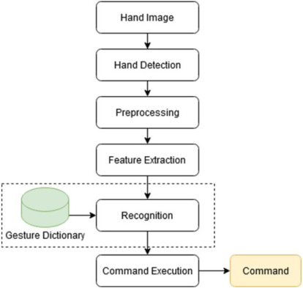
FLOW DIAGRAM

Slide 6
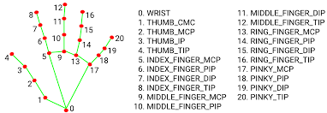

Slide 7
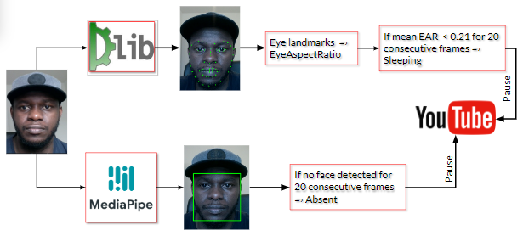

Slide 8
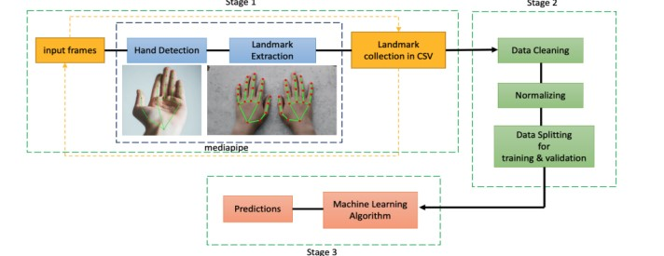

Slide 9
HAND GESTURE BASED ON MEDIAPLAYER CONTROL SYSTEM DATASET
A database is a structured collection of organized data that is designed to be easily accessed, managed, and updated. It serves as a centralized repository for storing and retrieving information efficiently, enabling users to store, manipulate, and query data in a systematic manner. Databases typically consist of one or more tables, each containing rows and columns representing individual records and attributes, respectively. These tables are interconnected through relationships, facilitating the retrieval of related data across multiple tables. Databases are essential components of modern software systems, supporting a wide range of applications such as e-commerce platforms, customer relationship management (CRM) systems, and financial management software.

Slide 10
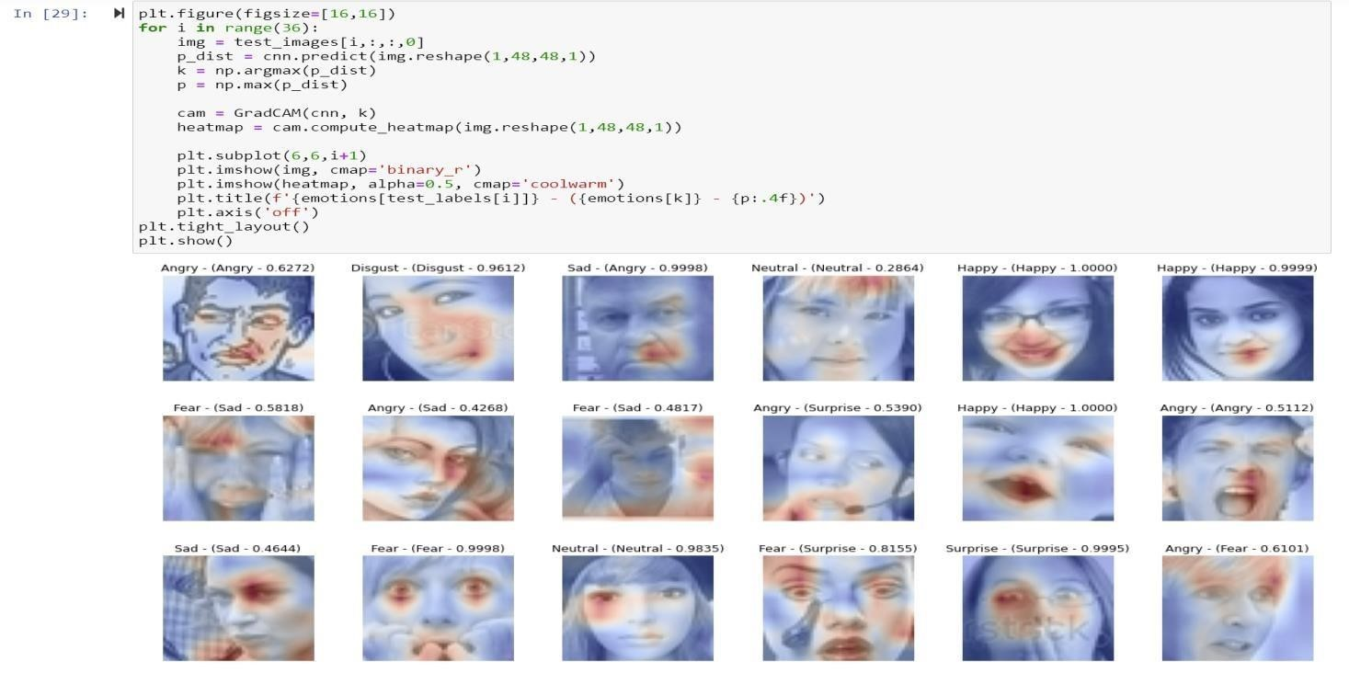

Slide 11
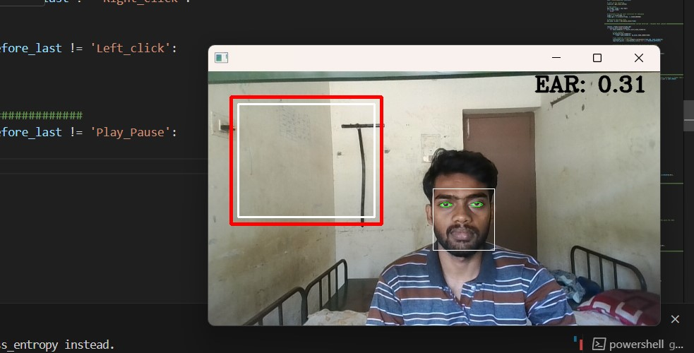

Slide 12
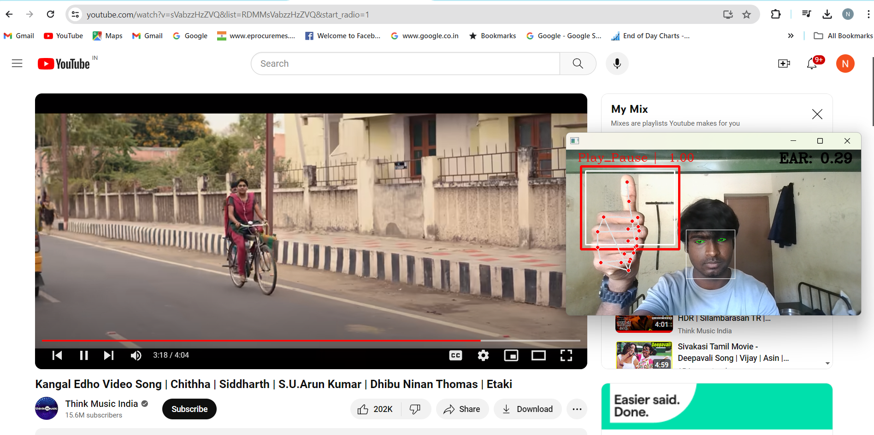

Slide 13
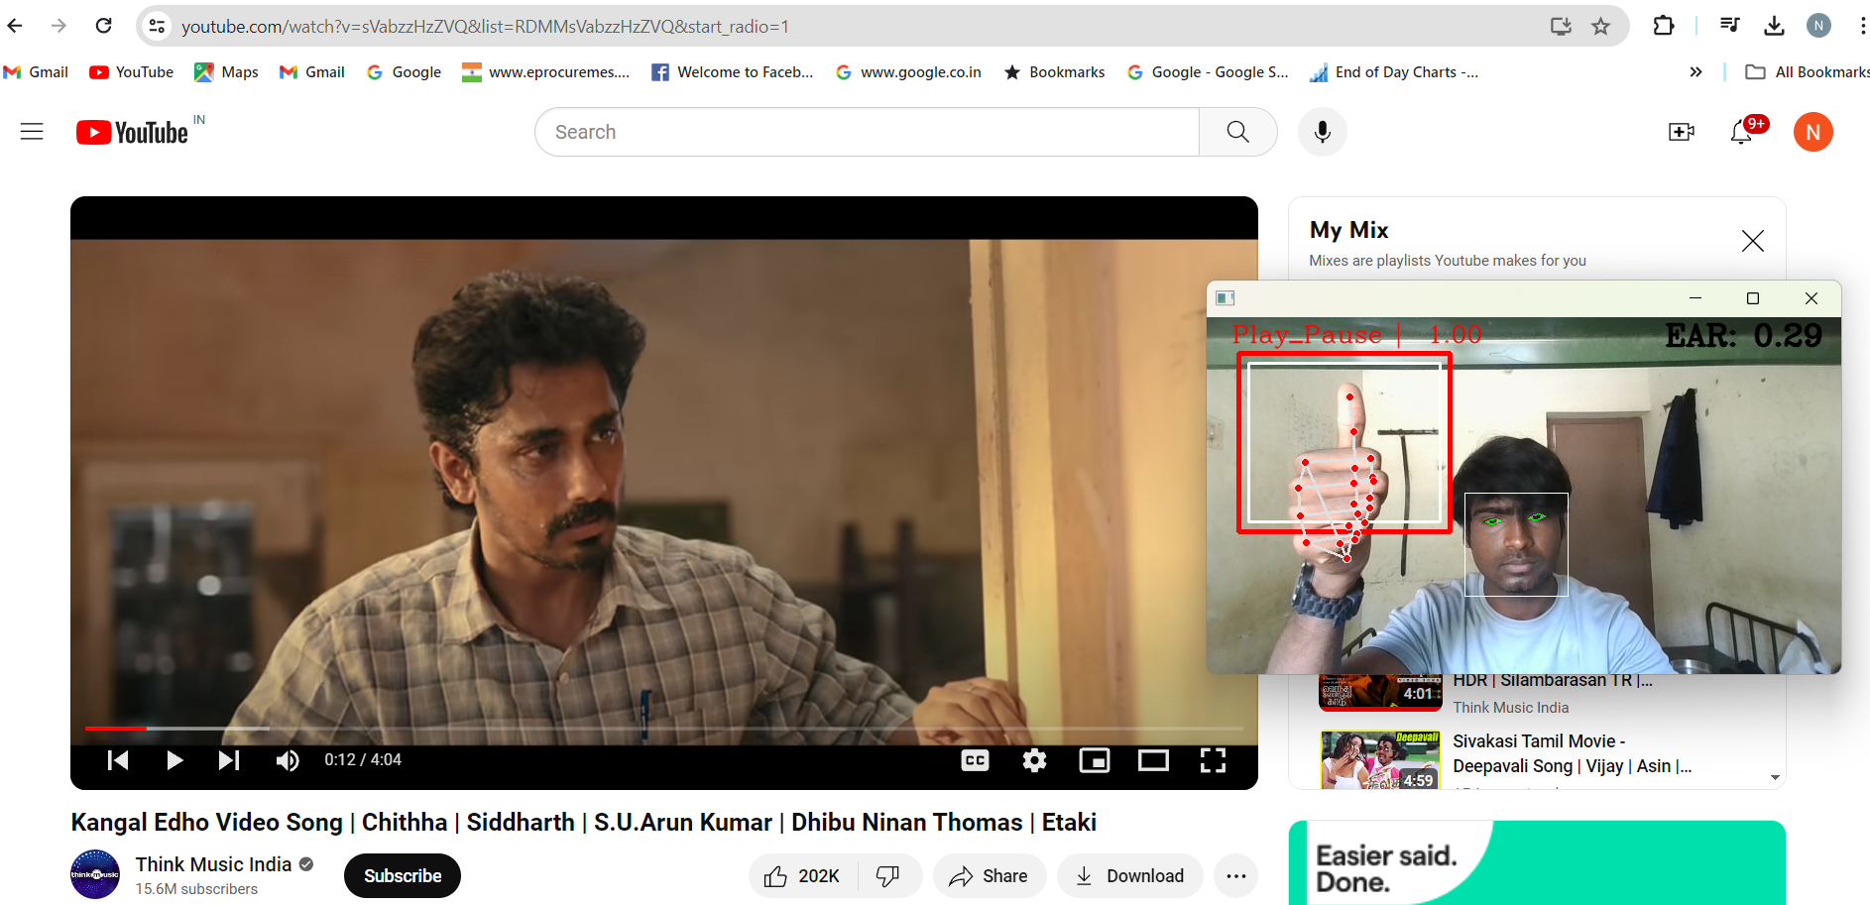

Slide 14
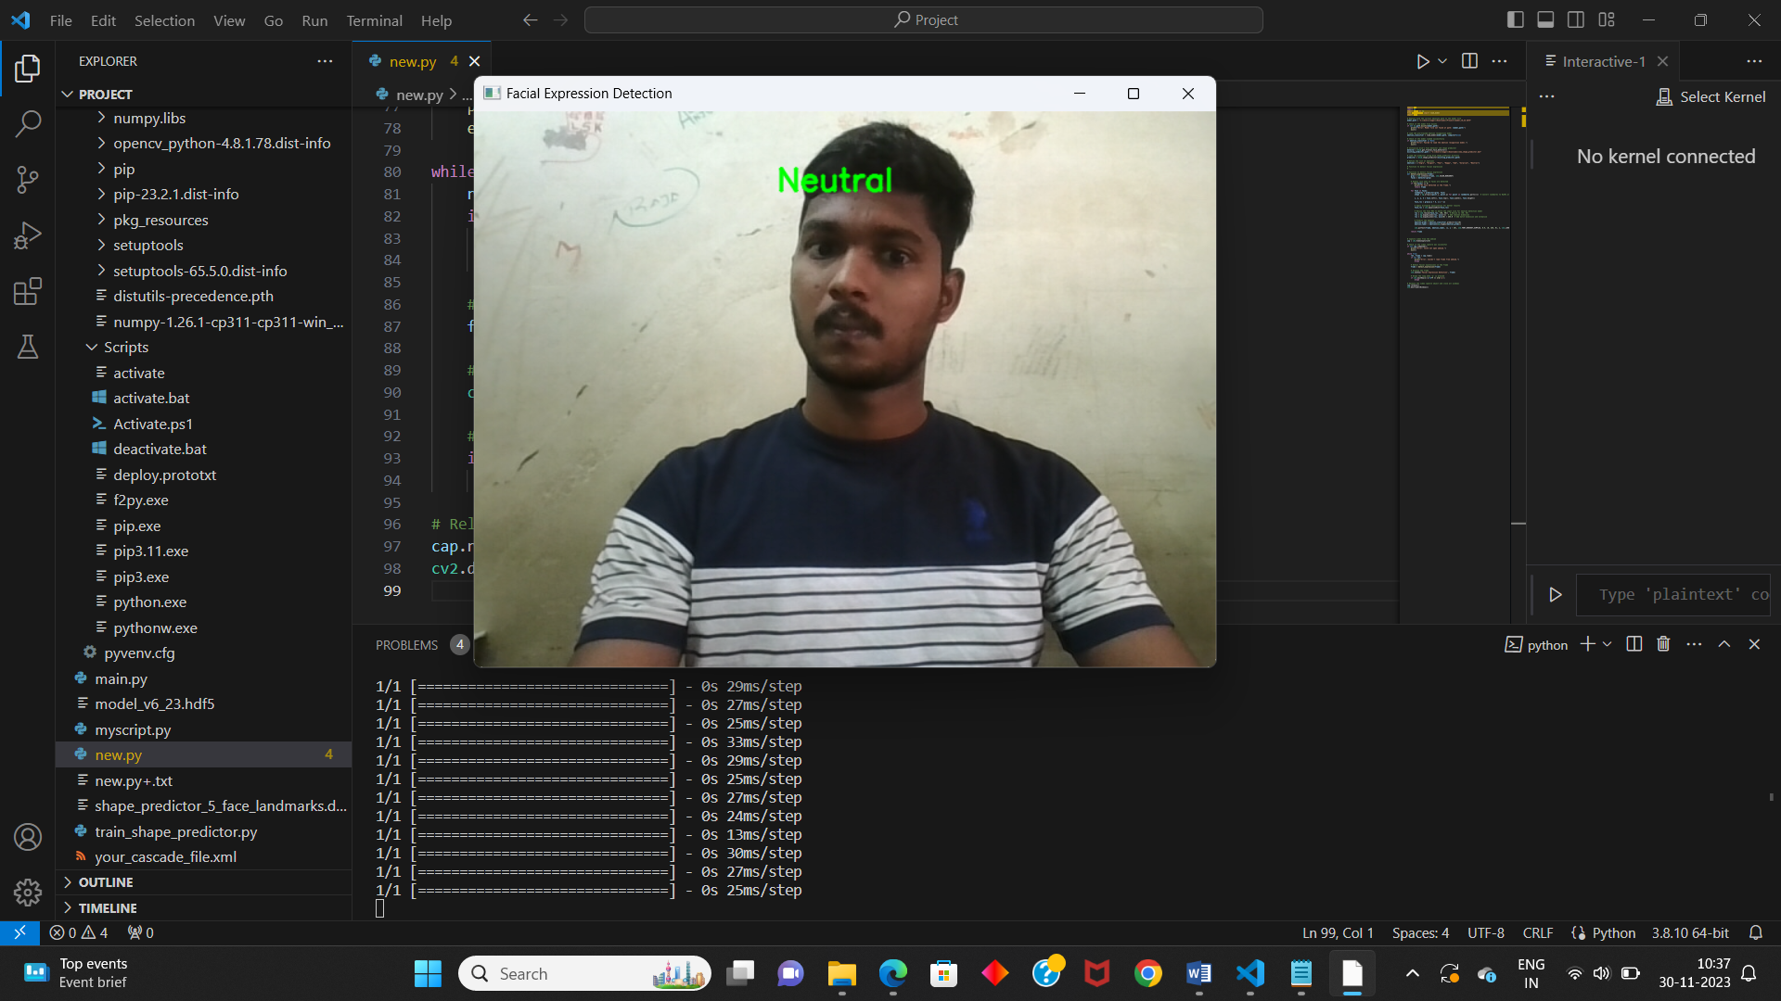

Slide 15
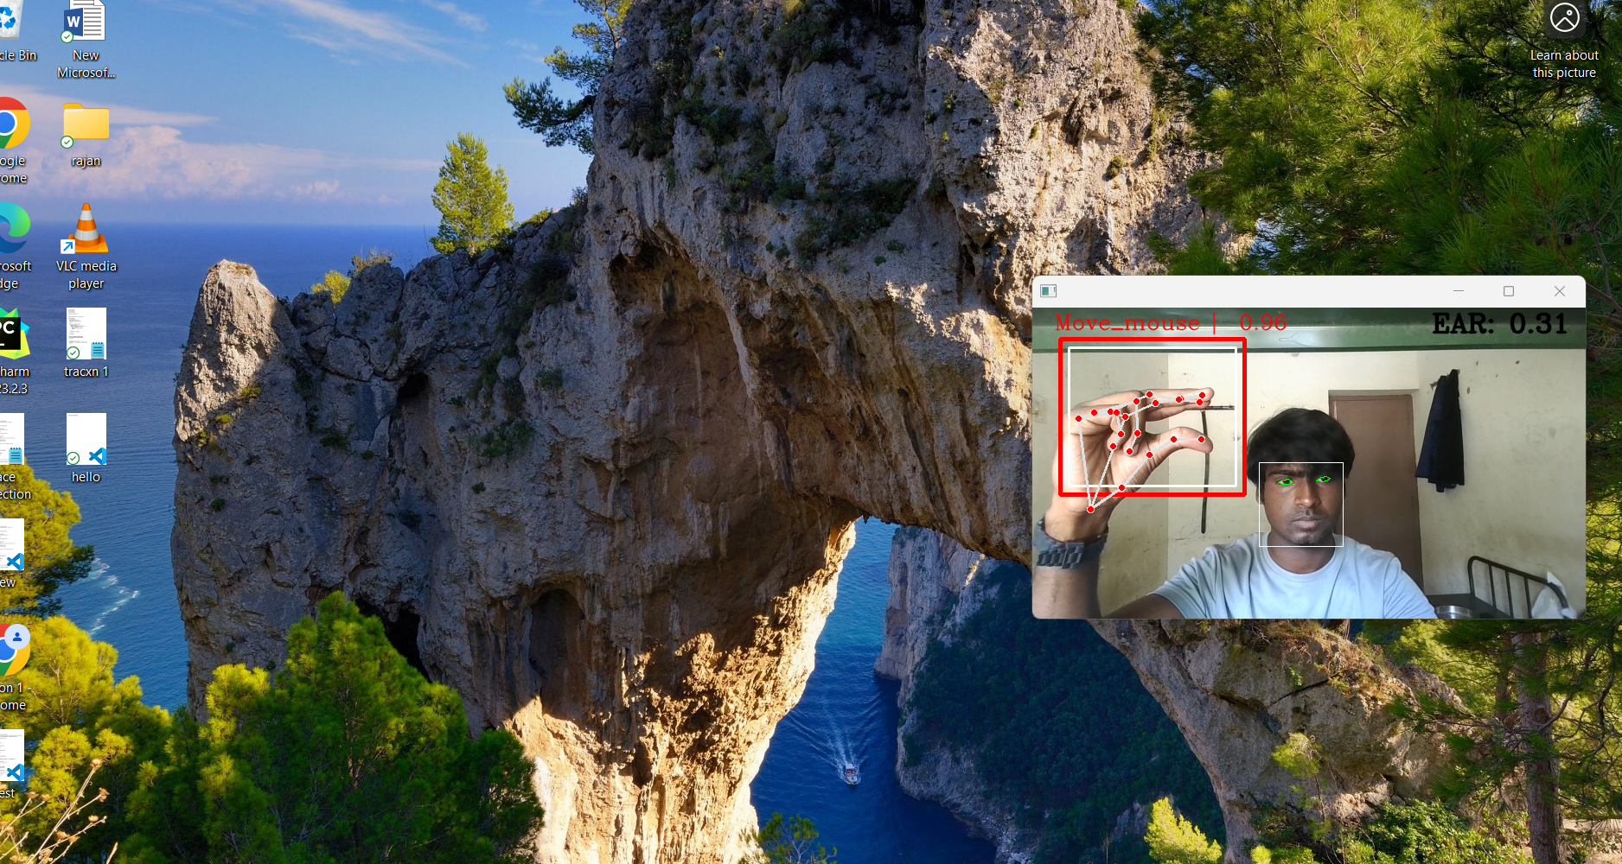

Slide 16
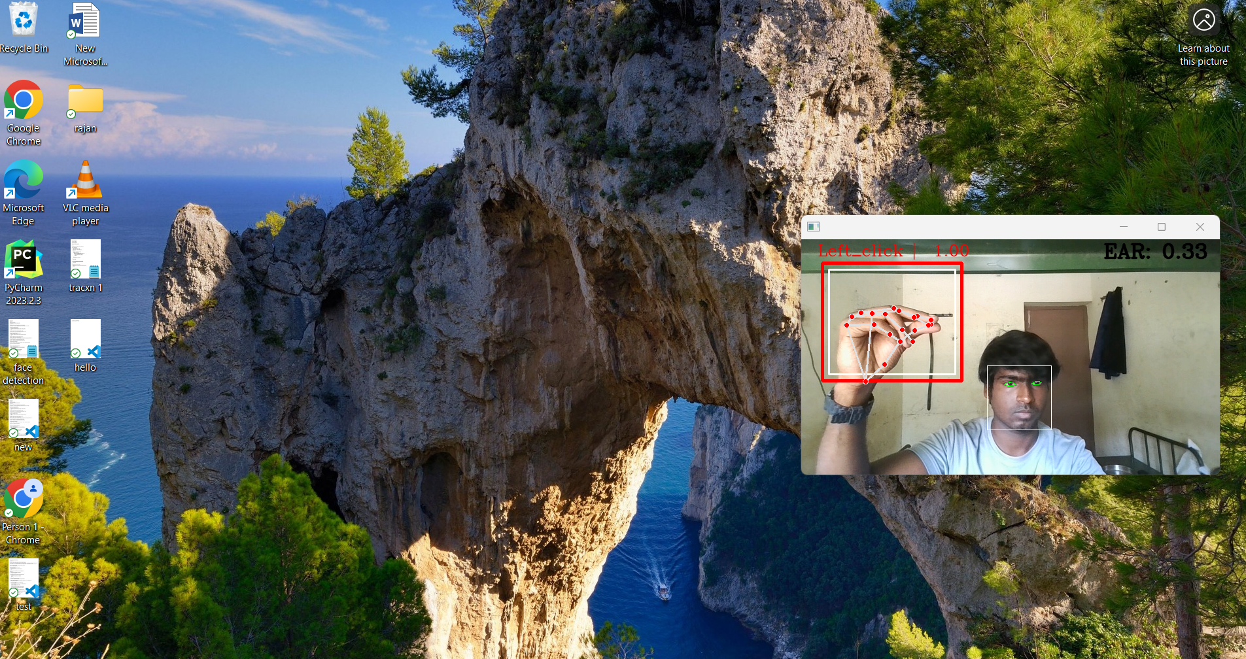

Slide 17
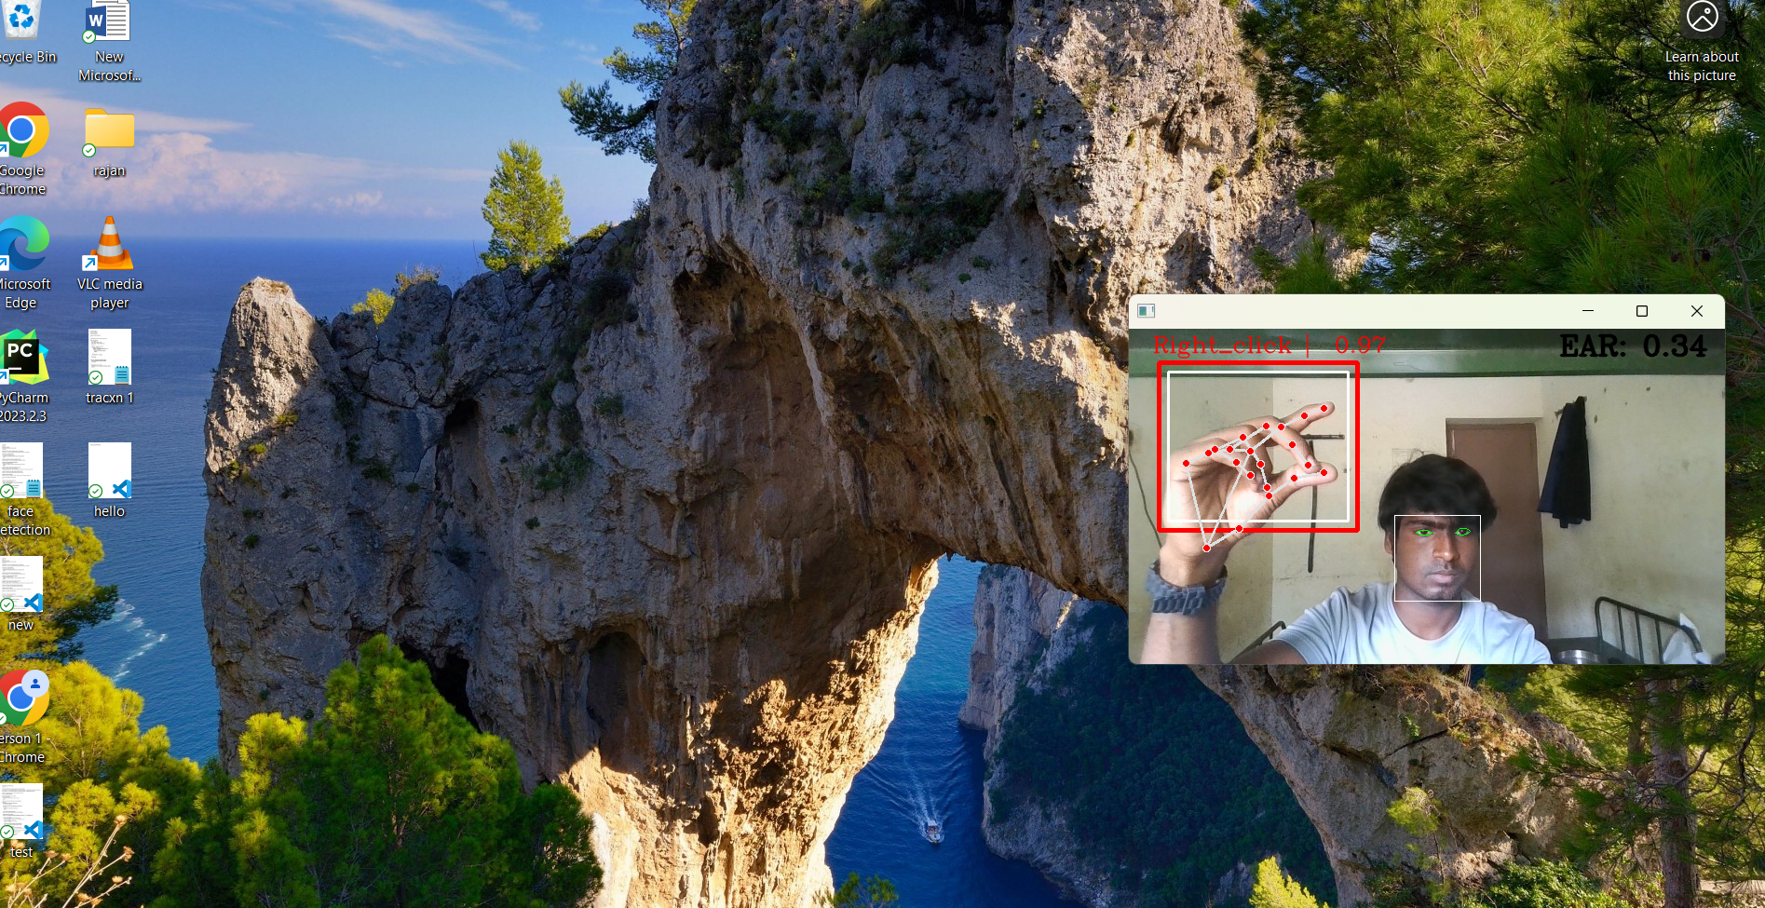

Slide 18
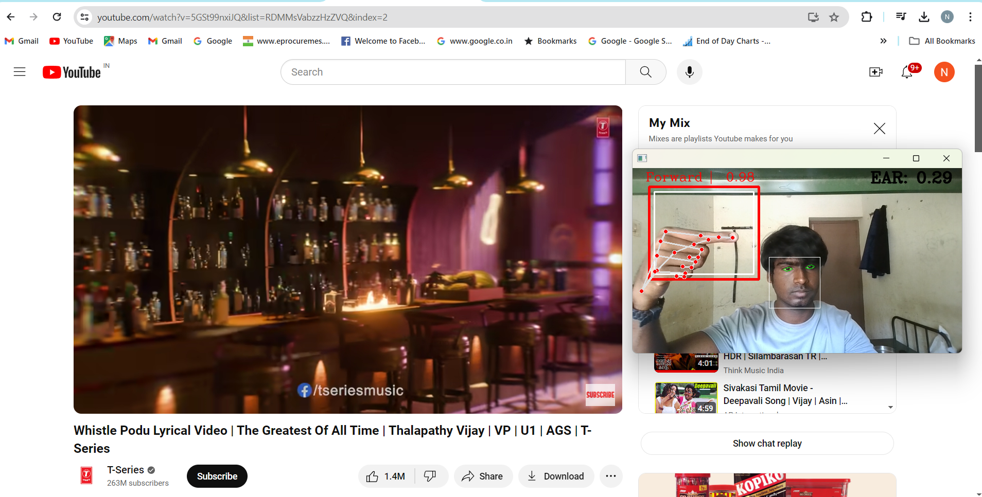

Slide 19
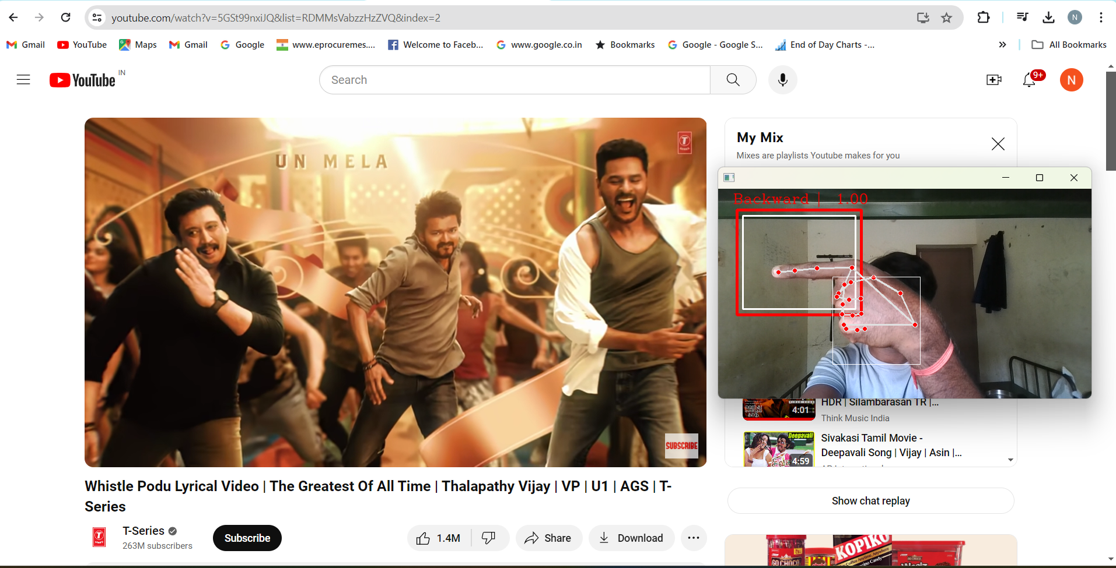

Slide 20
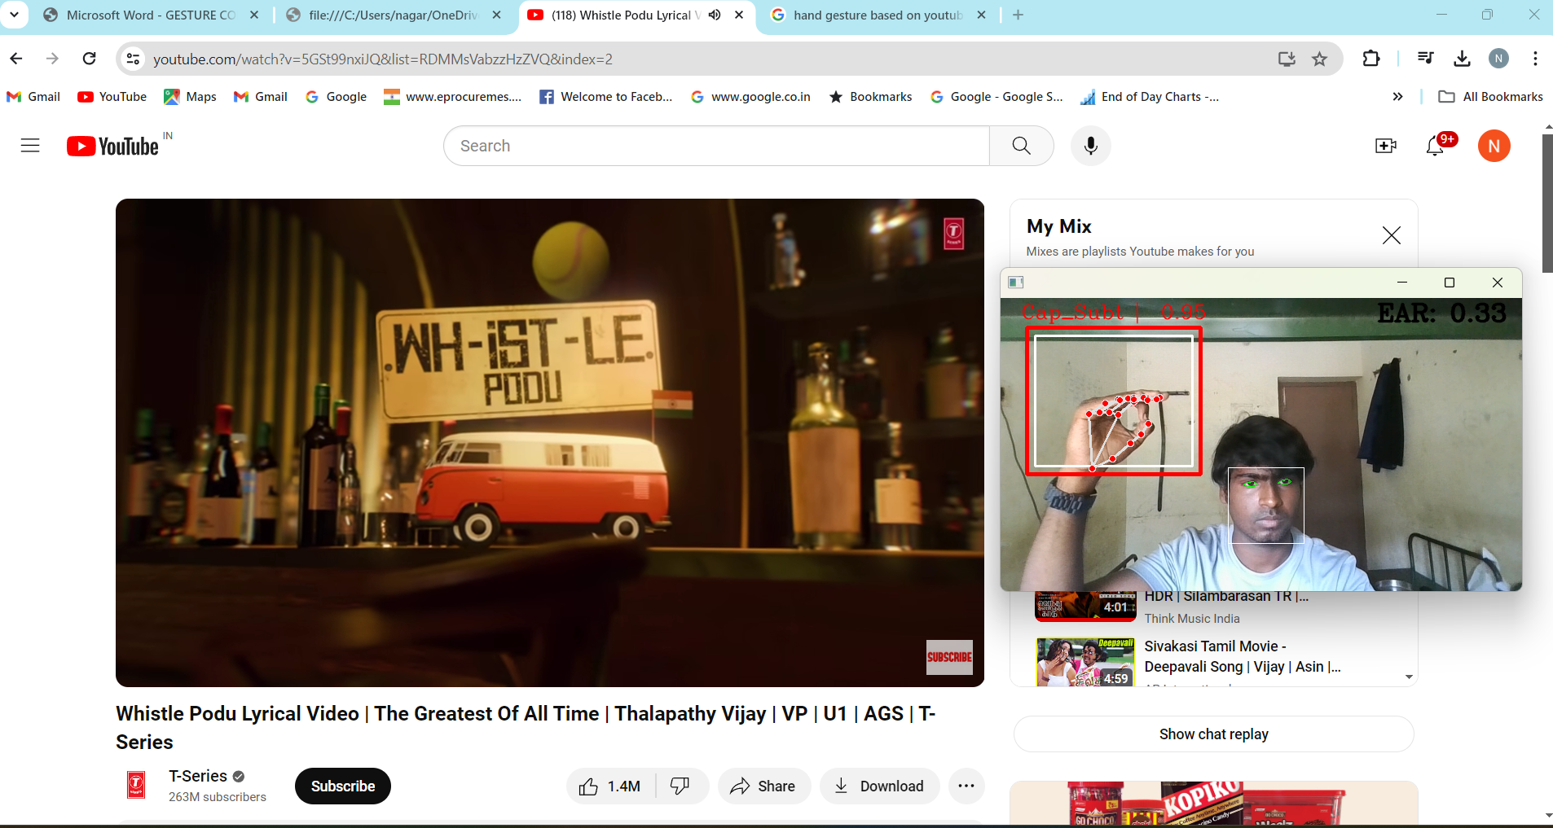

Slide 21
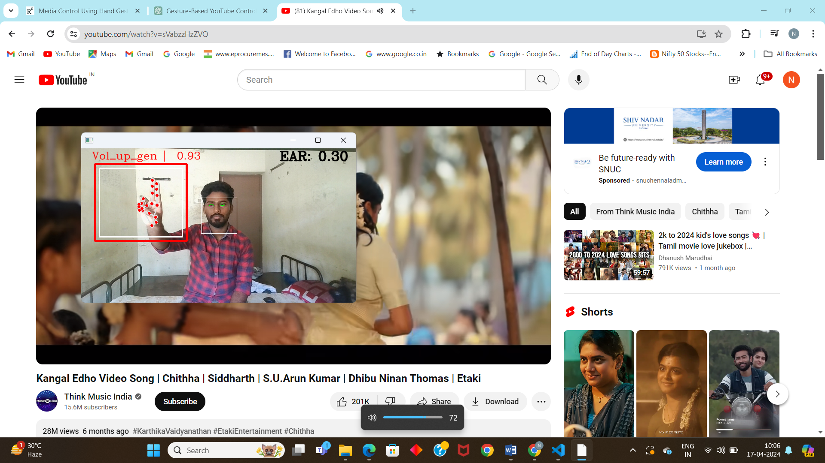

Slide 22
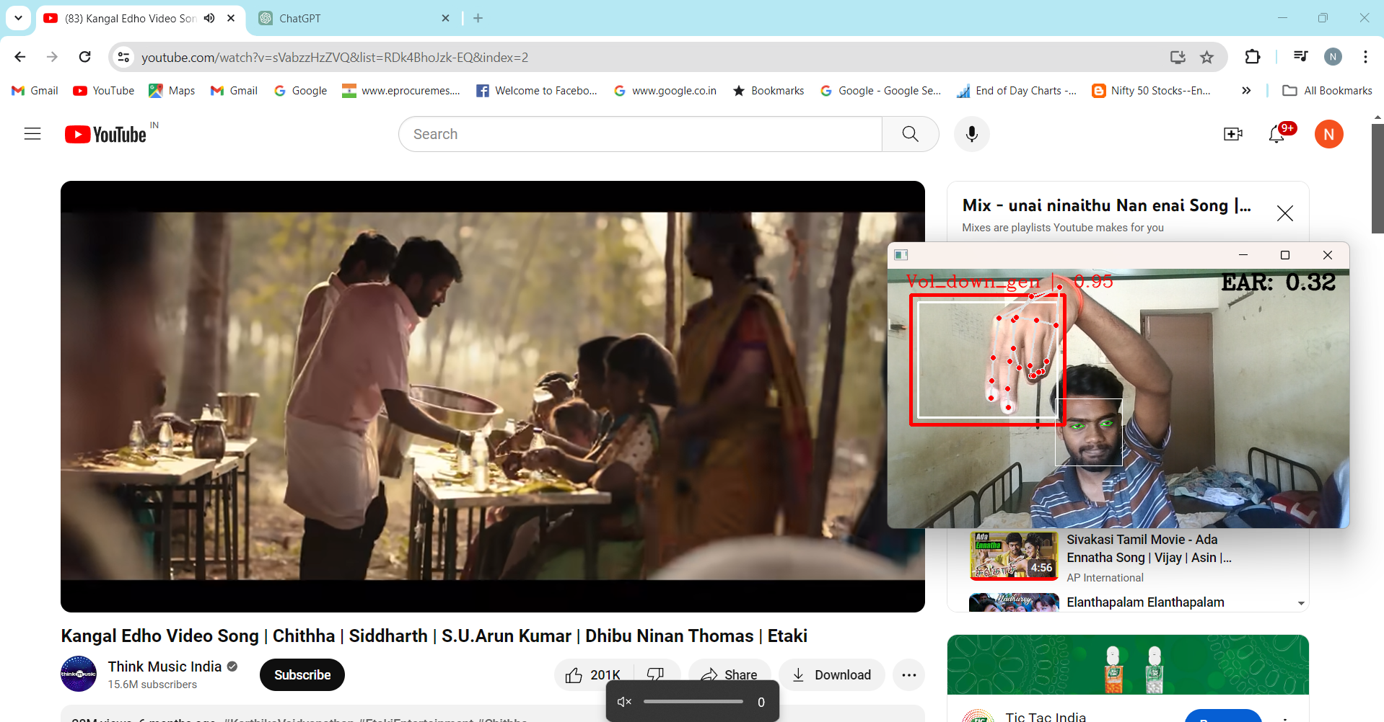

Slide 23
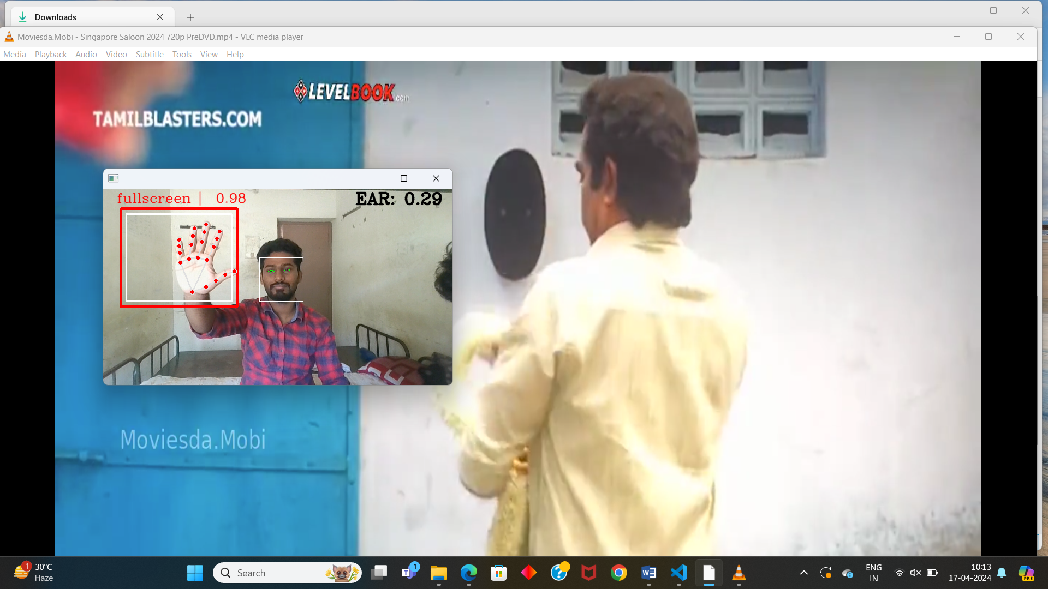

Slide 24
FUTURE ENHANCEMENT
Explore advanced machine learning techniques to enhance gesture recognition accuracy and robustness.
Experiment with different hand pose estimation models to effectively capture subtle gestures and variations in hand movements.
Allow users to define and customize their own hand gestures for personalized YouTube playback control.
Implement a calibration process for users to train the system to recognize their unique hand gestures and preferences.
Integrate voice commands and facial expressions alongside hand gestures to provide users with more control options.
Develop algorithms to interpret inputs from multiple modalities, enabling natural and context-aware interactions.
Implement real-time visual feedback mechanisms for immediate confirmation and guidance on recognized gestures.

Slide 25
CONCLUSION
Imports necessary libraries such as OpenCV, MediaPipe, dlib, and pandas for video processing and hand/facial detection.
Initializes parameters and variables including camera settings, hand detector, model paths, and confidence thresholds.
Enters a loop to continuously capture frames, detect hand gestures, and control YouTube playback.
Uses MediaPipe for hand gesture detection, predicting gestures, and mapping them to control actions like play/pause and volume adjustment.
Analyzes facial landmarks to detect sleepiness based on eye aspect ratio and pauses video playback accordingly.
Utilizes MediaPipe's face detection to detect absence of a face and pauses playback if no face is detected.
Displays webcam feed with overlays indicating detected gestures, eye aspect ratio, and face bounding boxes for debugging purposes.
Terminates the loop when the user presses the 'q' key.

Slide 26
THANK YOU

